Slide 1



Raster lidar data visualizations for interpretation of microrelief structures
dr. Žiga Kokalj
2014
Research Centre of the Slovenian Academy of Sciences and Arts (ZRC SAZU)
Centre of Excellence for Space Sciences and Technologies (Space-Si)

Slide 2
Why different visualizations?

Slide 3
Lidar and past cultural landscapes
forest cover in Europe is growing
  Slovenia: 39% --> 60% in the last century
DEM’s and DSM’s are mainly provided by lidar operators or national mapping authorities
they are not optimised for archaeological detection or interpretation
DTM – DSM
advanced visualisation is rarely used

Slide 4
Visualizations
simplify interpretation of features
there is more to visualizations than shaded relief
interpretation based solely on shaded relief has a big potential to miss important archaeological features (Challis et al. 2008. Antiquity)

Slide 5
Visualizations
1 Analytical hill-shading
2 PCA of hill-shadings
3 Colour cast
4 Trend removal
5 Slope gradient
6 Sky view factor
7 Openness
8 Solar insolation
Kokalj et al. 2011. Antiquity.
Kokalj et al. 2013. Visualizations of lidar derived relief models.

Slide 6
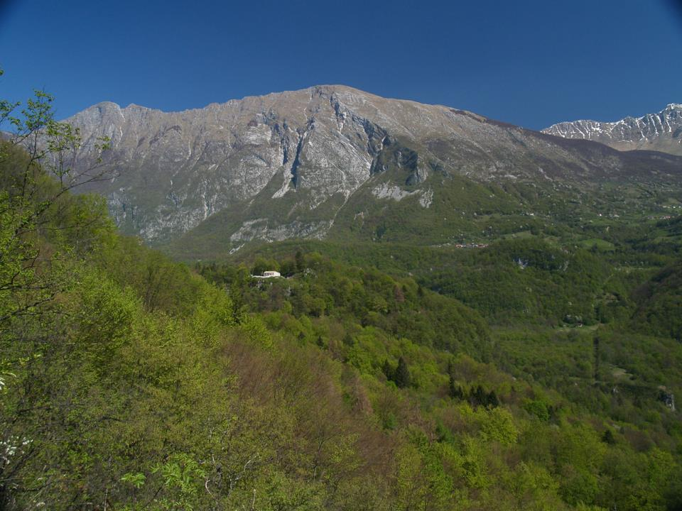
Tonovcov grad
one of the largest and most important Late Antiquity settlements in the south-eastern Alps
3 early Christian churches from the 5th century
Foto: Željko Cimprič

Slide 7
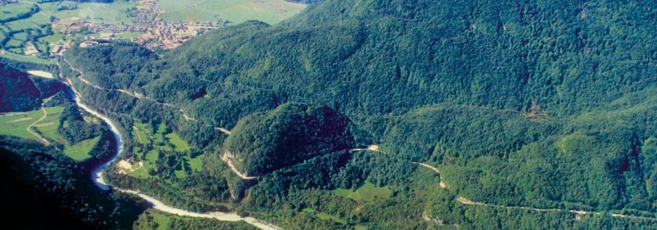
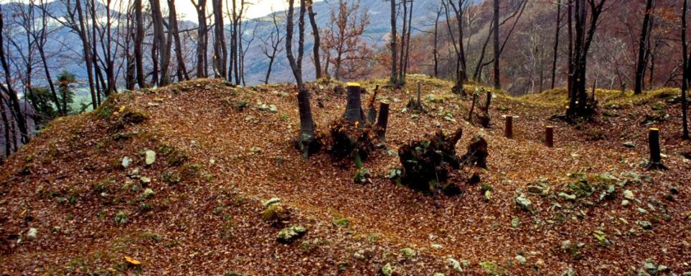
Foto: Slavko Ciglenečki

Slide 8
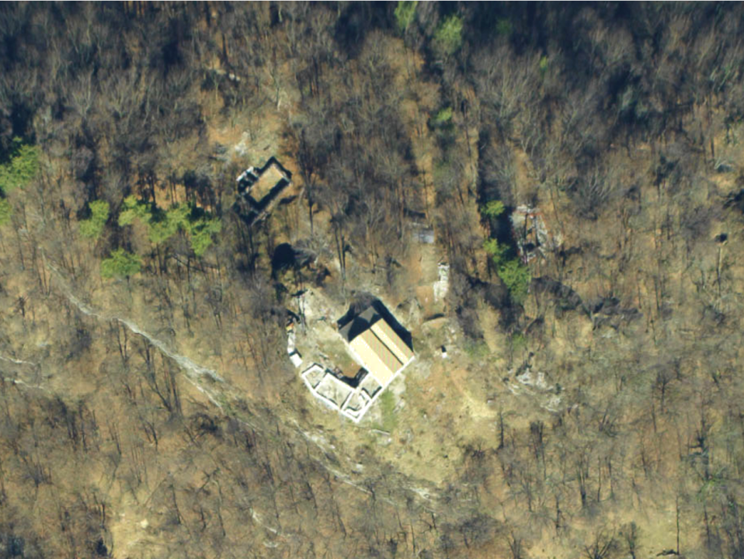
Digital orthophoto
0
50 m

Slide 9
Lidar survey
Scanning
scanner type | Riegl LMS-Q560
platform | helicopter
date | 4th and 16th March 2007
swath width | 60 m
flying height | 450 m
average last and only returns per m² on a combined dataset | 11.2
Data processing
method | REIN (Kobler et al. 2007)
spatial resolution of the final elevation model | 0.5 m

Slide 10
Hill-shading
1
the most commonly used technique (Yoëli 1965. Kartographische Nachrichten)
greyscale colour table – enhances the perception of morphology
standard: azimuth at 315°, sun elevation at 45°
surface is illuminated by a direct light
constant for the entire dataset

Slide 11
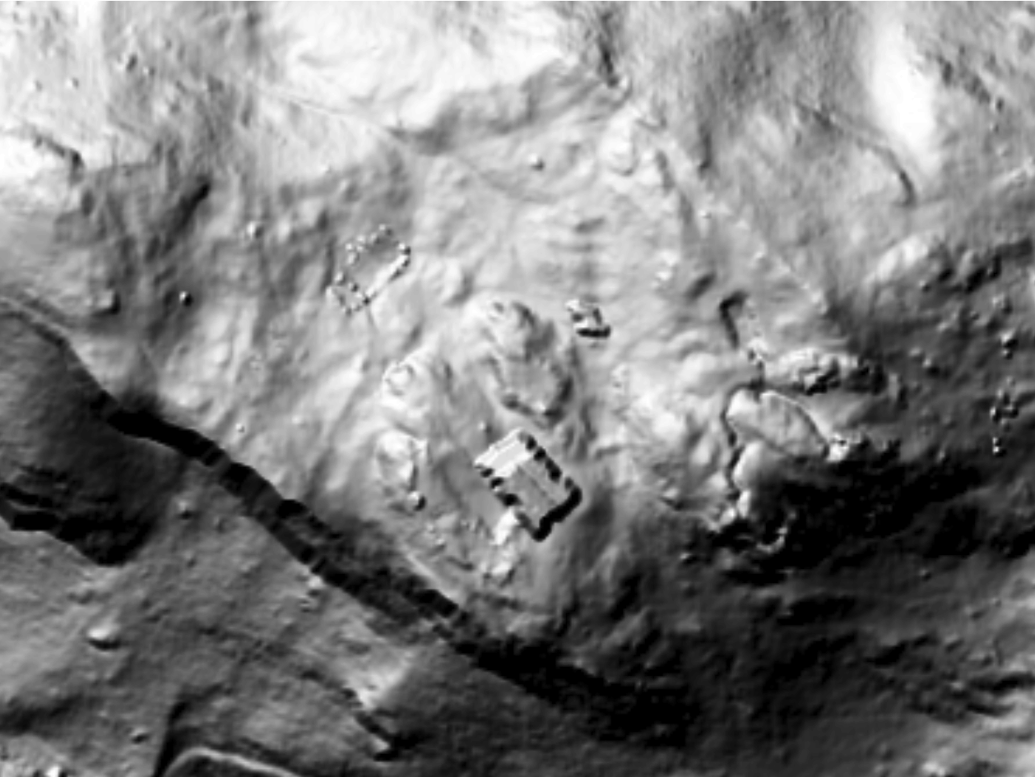
Shaded relief
Lidar Data Copyright
Walks of Peace in the Soča Region Foundation
315° 45°
0
50 m

Slide 12


Hill-shading
easy to compute and interpret
included in standard GIS software
reveals features with low light source on flat areas
dark shades and brightly lit areas
linear structures parallel to the light source

Slide 13
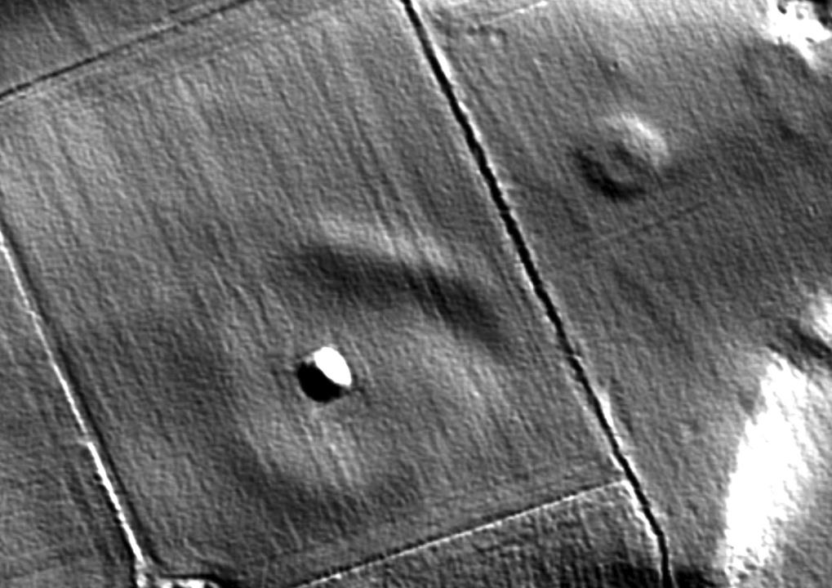
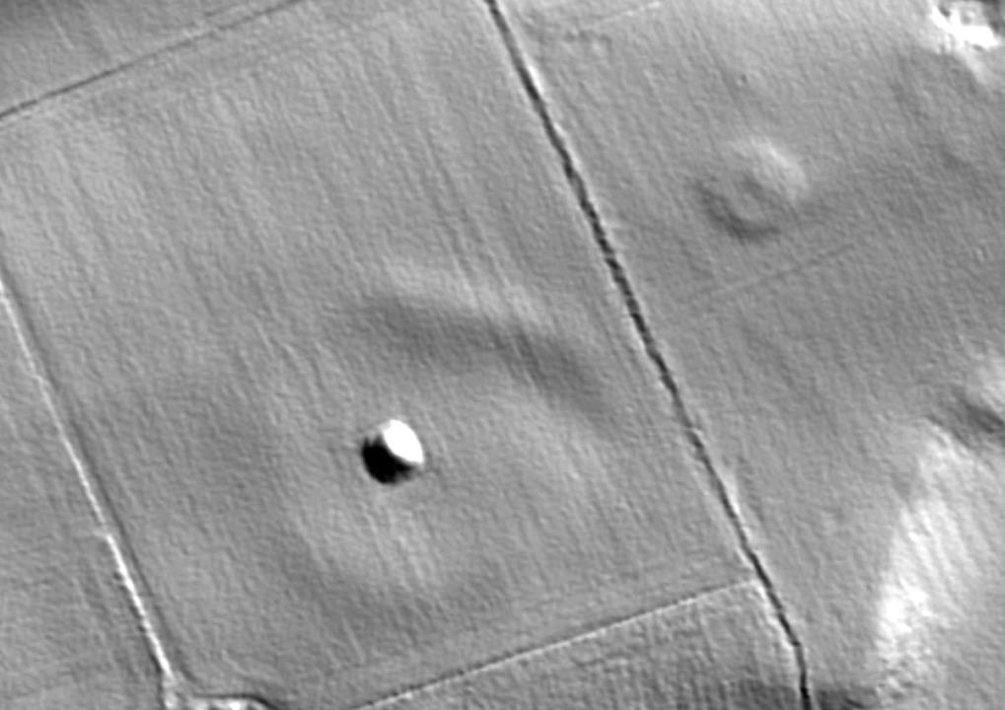
Low light shading
Lidar Data Copyright
Discovery Programme
45°
0
50 m
315°
5°

Slide 14
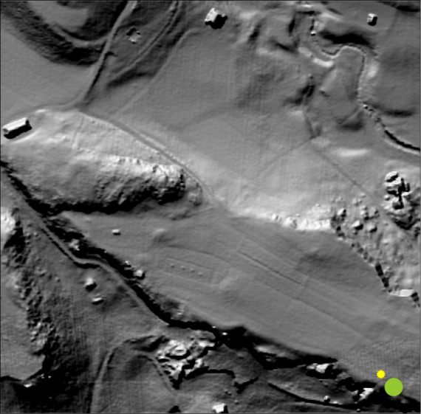
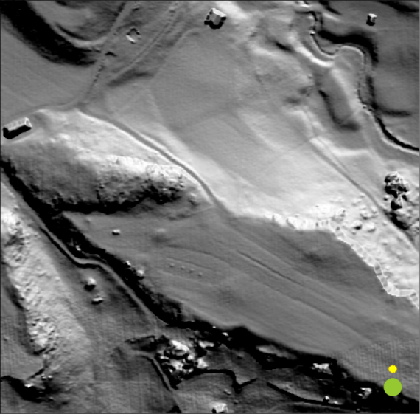
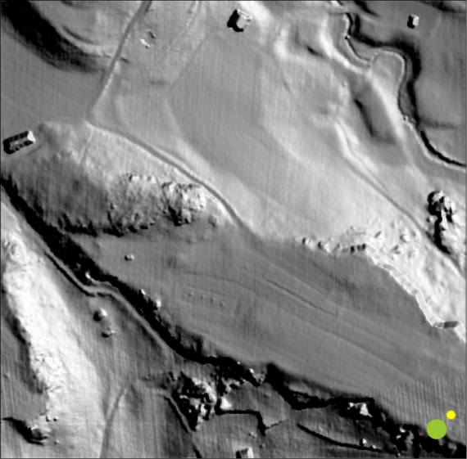
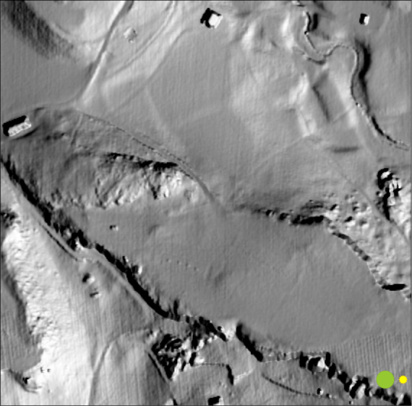
Illumination effects

Slide 15
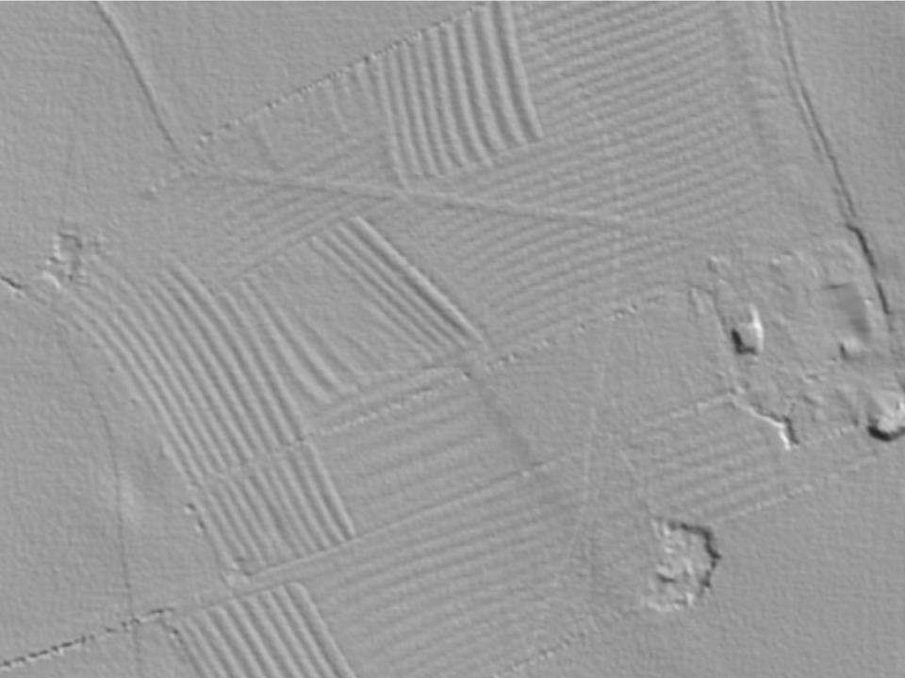
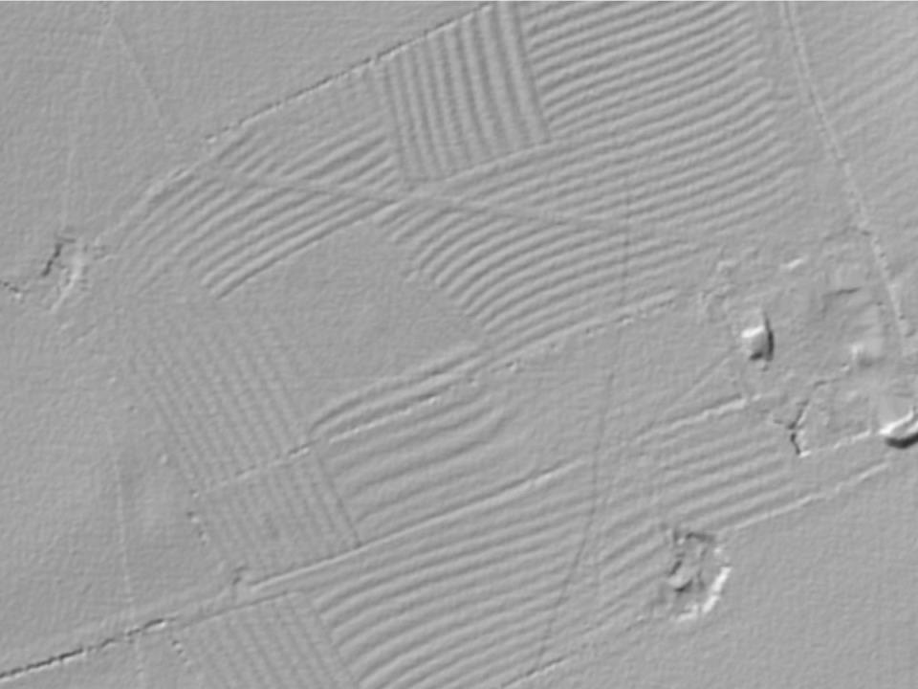
Typical ridge and furrow case study
Lidar Data Copyright
Infoterra Global Ltd
315°
45°
0
100 m
45°

Slide 16
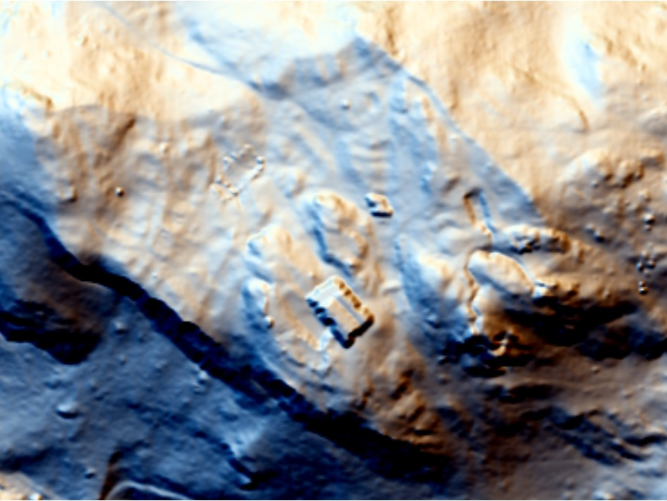
Hill-shading in multiple directions – RGB
RGB 0°, 337,5°, 315° 45°
0
50 m

Slide 17
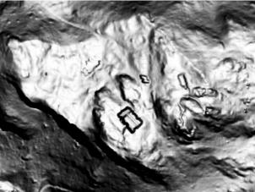
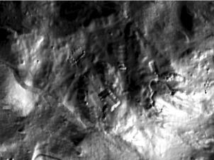

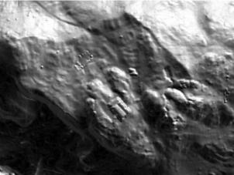
PCA of hill-shadings
2
summarizes information
  typically over 99% in the first three components
Devereux et al. 2008. Antiquity.
16 hill-shaded images
(100 %)
first 3 coponents
(> 99 %)

Slide 18
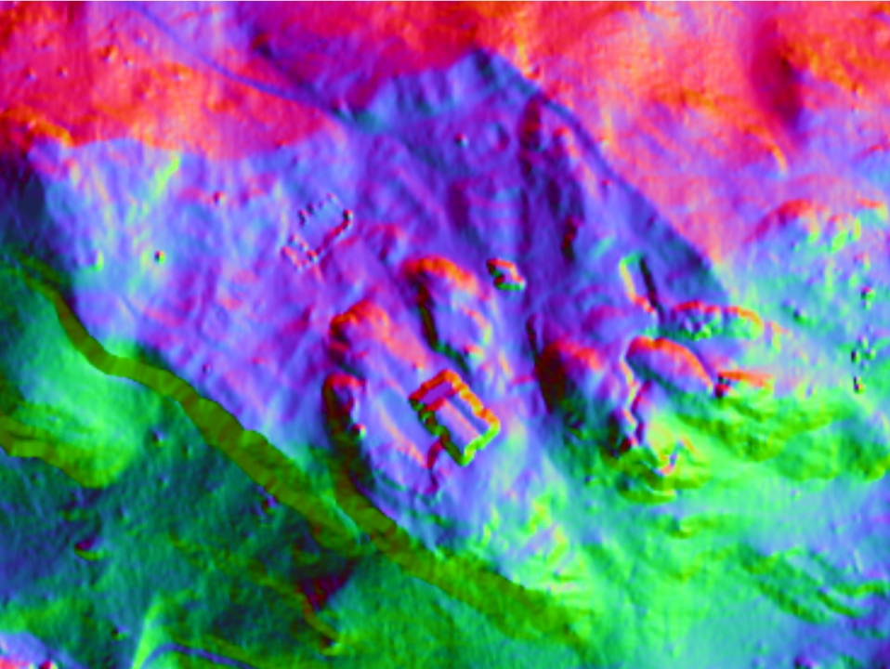
PCA of hill-shadings - RGB
16 45°
0
50 m

Slide 19
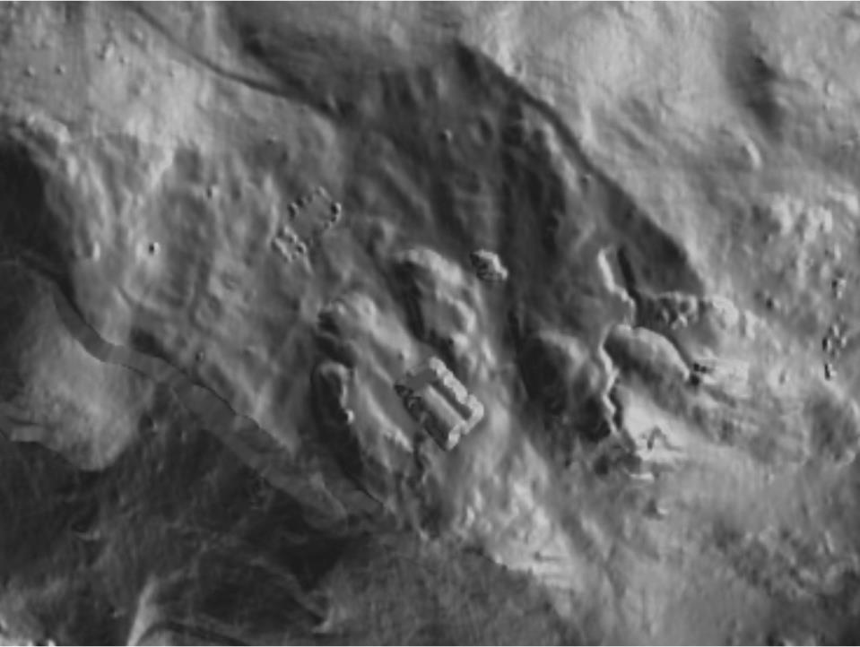
PCA of hill-shadings – bands 1 and 2
16 45°
0
50 m

Slide 20
PCA of hill-shadings
removes redundancy
does not provide consistent results with different datasets

Slide 21
Colour cast
3
histogram manipulation, colour ranging
limits the range of displayed values
Challis 2006. Archaeological Prospection.

Slide 22
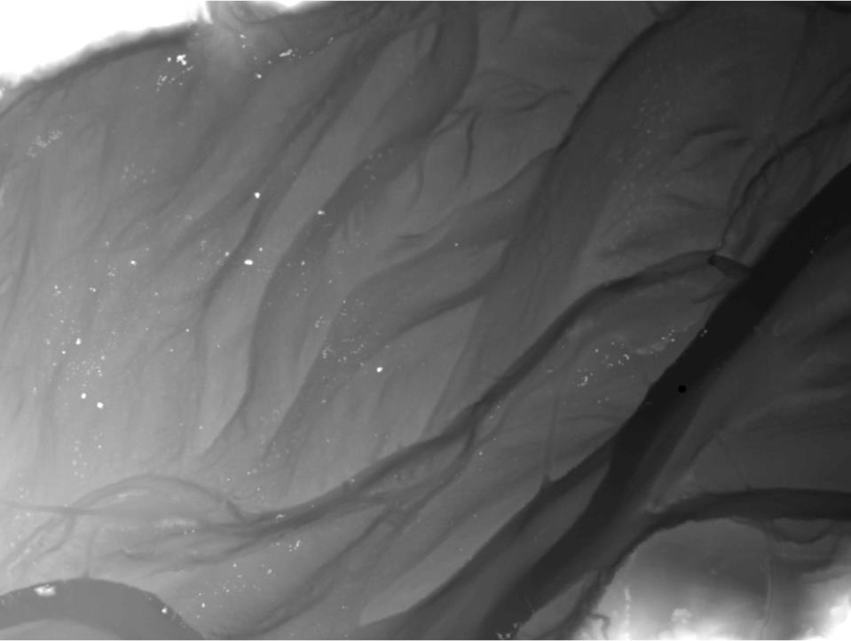
Colour cast
280 m
1220 m
270 m
190 m
0
100 m

Slide 23
Colour cast
useful in flat terrain
retains the display of original elevation data
easy to interpret
completely fails in rugged terrain
extensive manipulation is needed

Slide 24
Trend removal (LRM)
4
remove the trend in data so only small scale features remain
removes the height variation of “global” features
280 m
5 m
-5 m
240 m

Slide 25
Trend removal (LRM)
several methods to assess the trend:
  averaging
  median smoothing
  Gaussian smoothing
  improvement with a “purged DEM” (Hesse. 2010. Archaeological Prospection)

Slide 26
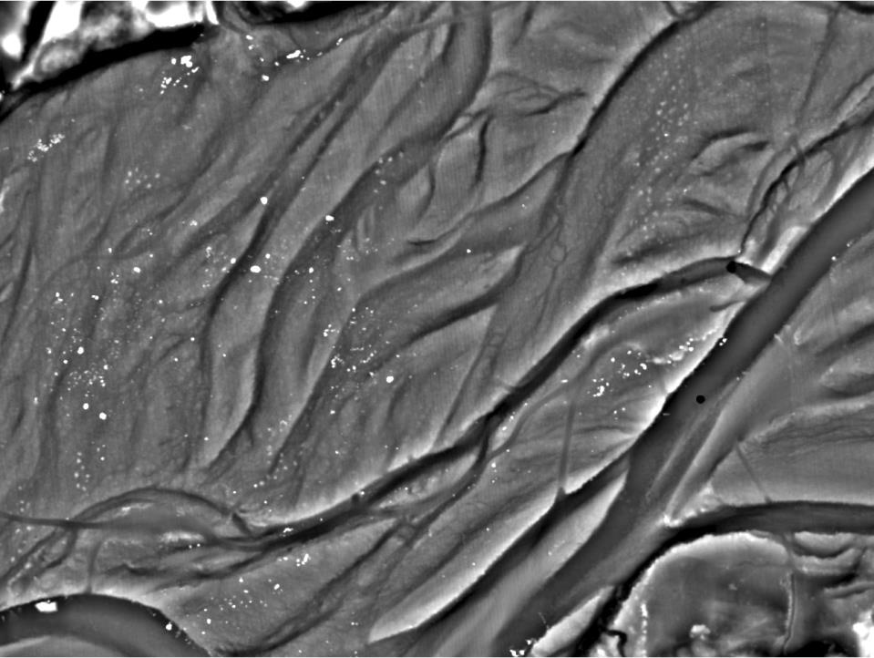
Trend removal (LRM)
280 m
1 m
270 m
-1 m
50 m Gaussian trend removal
0
100 m

Slide 27
Trend removal (LRM)
can be used as input to other methods
works extremely well with gentle slopes
level of smoothing
introduces artefacts (e.g. artificial banks and ditches)

Slide 28
Slope gradient
5
the first derivative of a DEM
inverted greyscale retains relief representation
Doneus et al. 2006. BAR International Series.

Slide 29
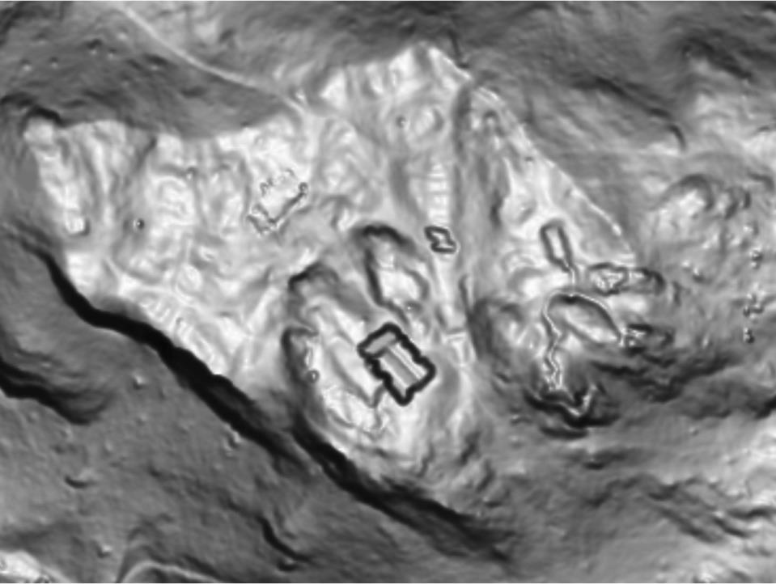
Slope gradient
90°
0°
0
50 m

Slide 30
Slope gradient
easy to compute and interpret
included in standard GIS software
works well in combination with hill-shading
works well on most types of terrain
retains saturated areas
additional information needed for interpretation

Slide 31
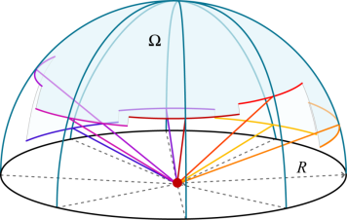
Sky View Factor
6
determines the size of the visible sky
elevation angle is determined into multiple directions and to the given distance
considers a hemisphere only
values between 0 and 1
Kokalj et al. 2011. Antiquity.

Slide 32
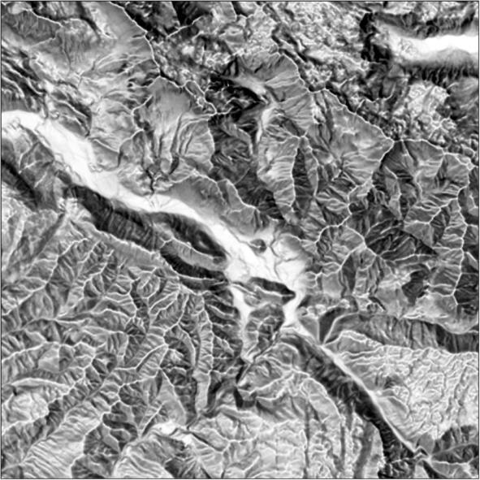
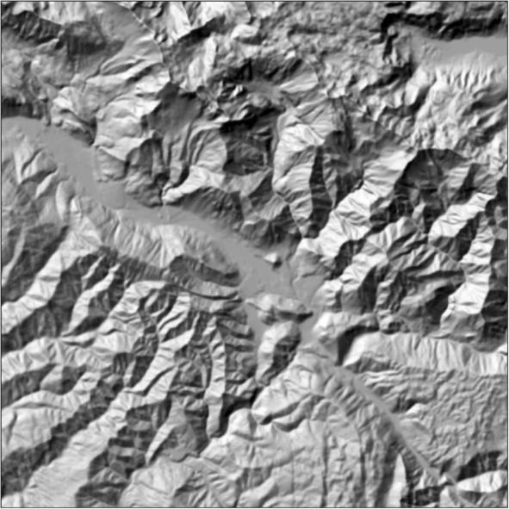


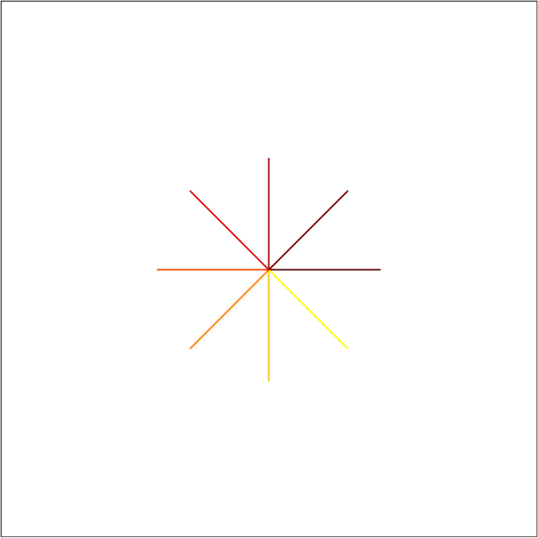
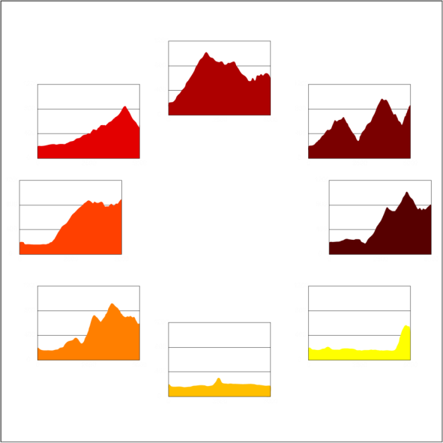
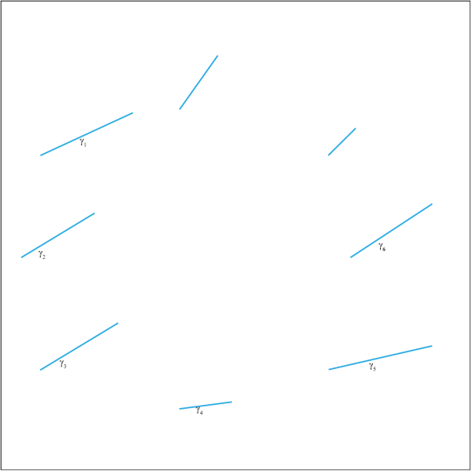
Sky View Factor

Slide 33
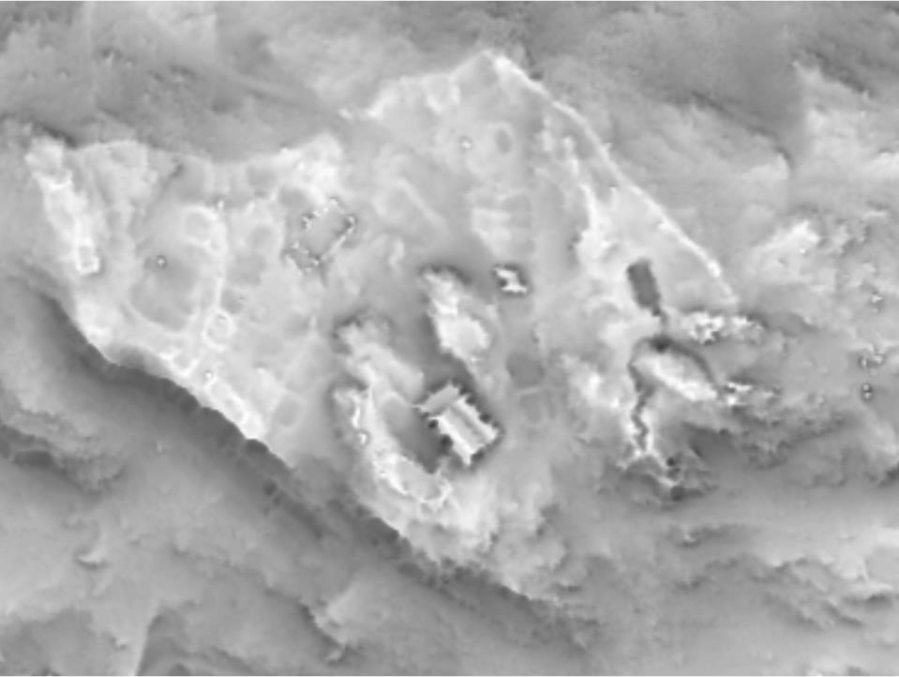
Sky View Factor
1
0
16 10 m (20 px)
0
50 m

Slide 34
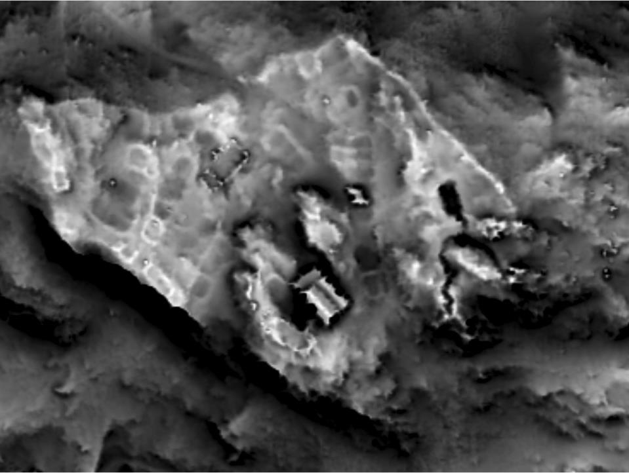
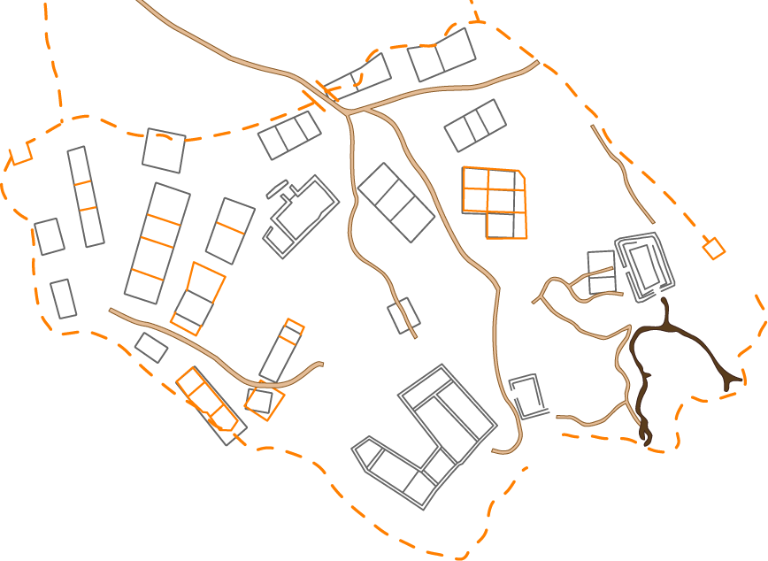
Sky View Factor
1
0.6
16 10 m (20 px)
0
50 m

Slide 35
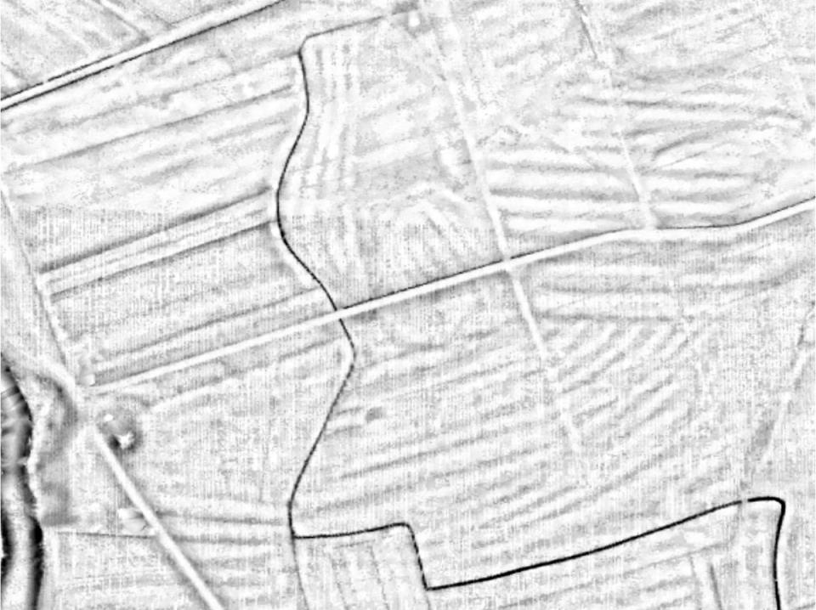
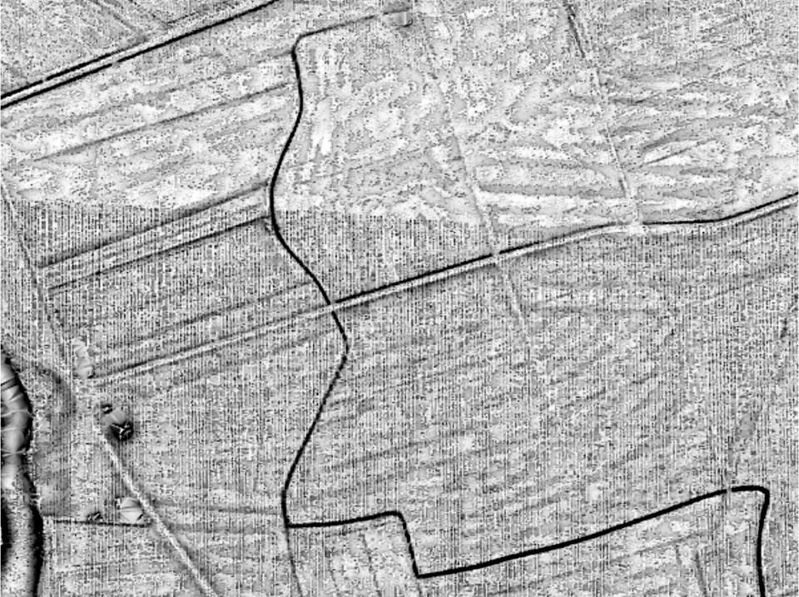
SVF – Noisy data
Lidar Data Copyright
State Office for Cultural Heritage Baden-Wurttemberg
16 10 m (10 px)
0
100 m

Slide 36
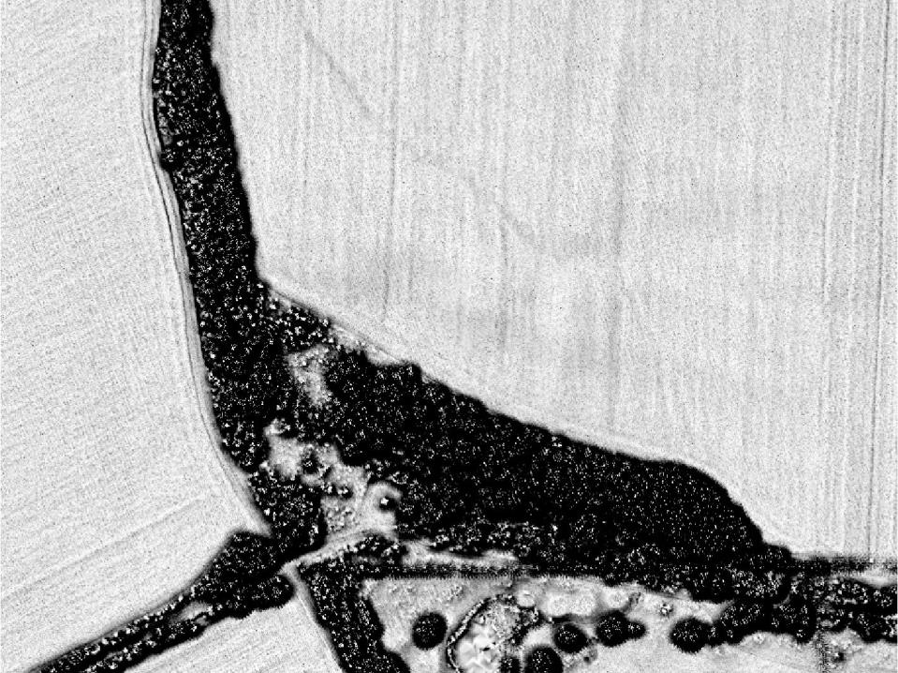
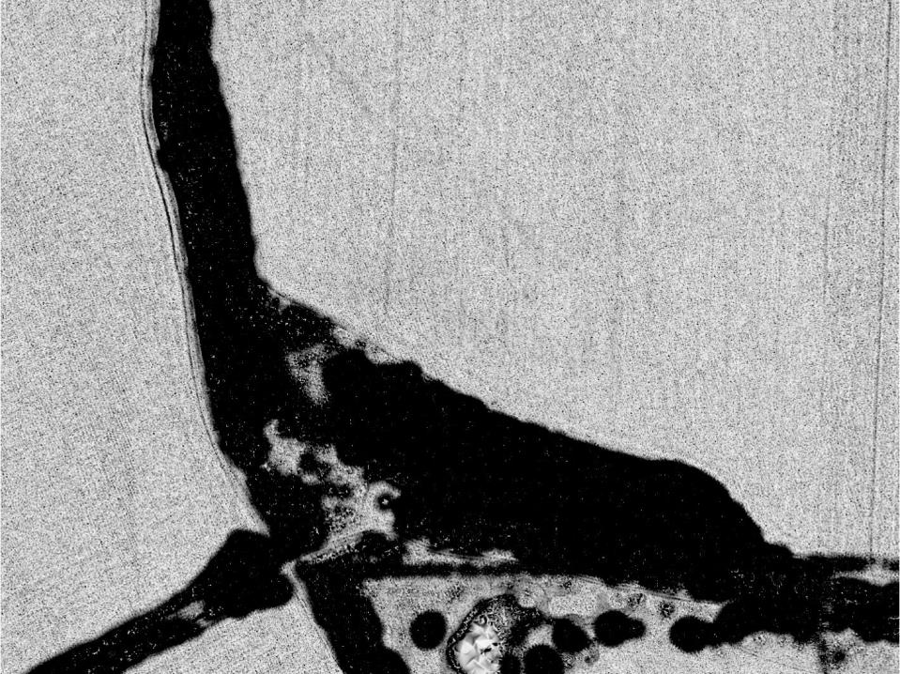
Anisotropic SVF
1
0.8
Lidar Data Copyright
Janus Pannonius Archaeology Museu
16 10 m (20 px)
0
100 m

Slide 37
Sky View Factor
no saturations
clear distinction between protruding features and depressions
particularly useful for complex features
helps with noisy data
intuitive
“washout effect” on very flat terrain with very low protruding features

Slide 38
Openness
7
quantifies the degree of unobstructedness of a location
very similar to SVF
positive and negative
Doneus 2013. Remote Sensing.

Slide 39
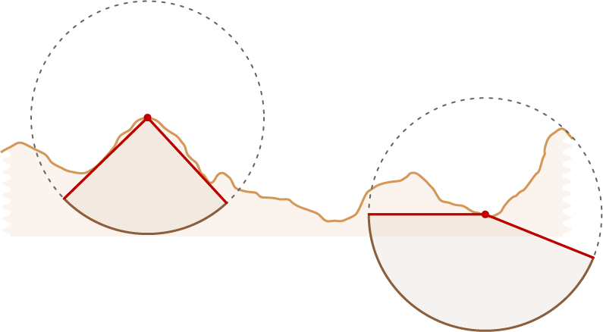
Comparison SVF - Openness
SVF
positive openness
negative openness

Slide 40
Comparison SVF - Openness
SVF
positive openness

Slide 41
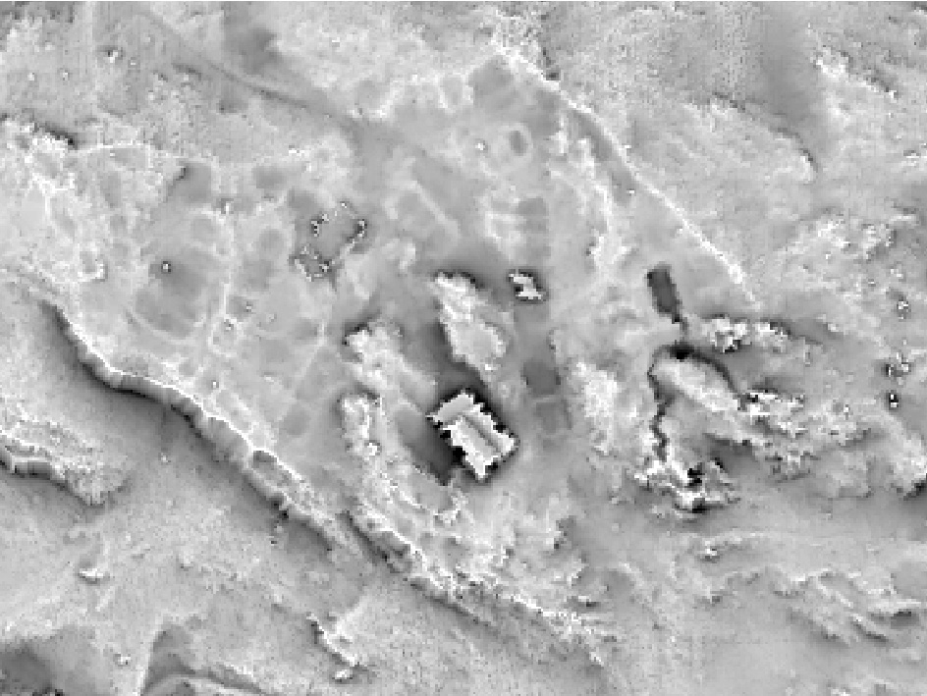
Openness – positive
95°
50
16 10 m (20 px)
0
50 m

Slide 42
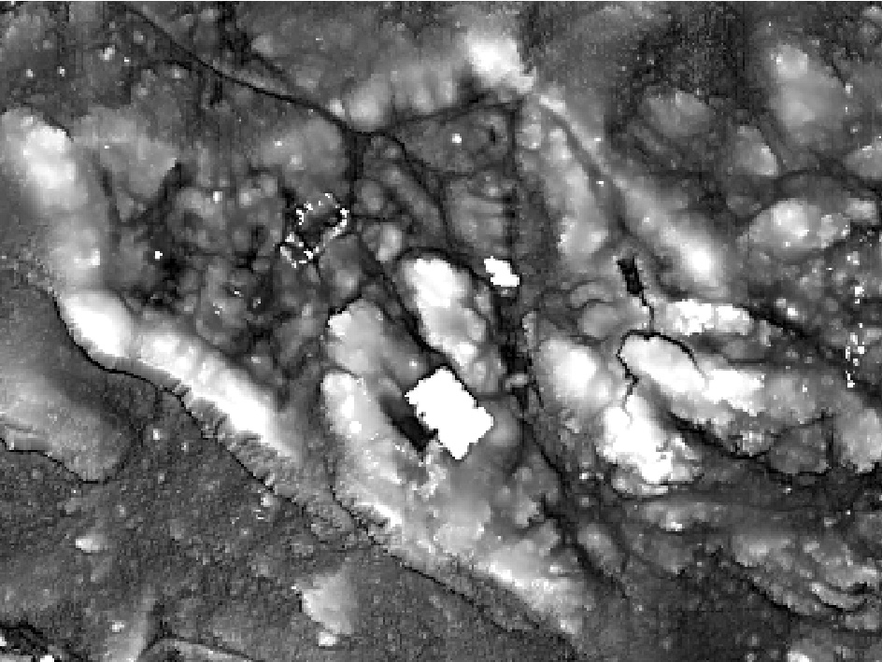
Openness – negative
95°
50
16 10 m (20 px)
0
50 m

Slide 43
Openness
no saturations
enhances concavities and convexities
useful for complex features
completely removes general topography
useful for automatic detection
the same value on different slopes
negative openness not very intuitive to interpret

Slide 44
Solar insolation
8
amount of the solar energy received at the surface
direct, diffuse and global solar insolation
Challis et al. 2011. Archaeological Prospection.

Slide 45
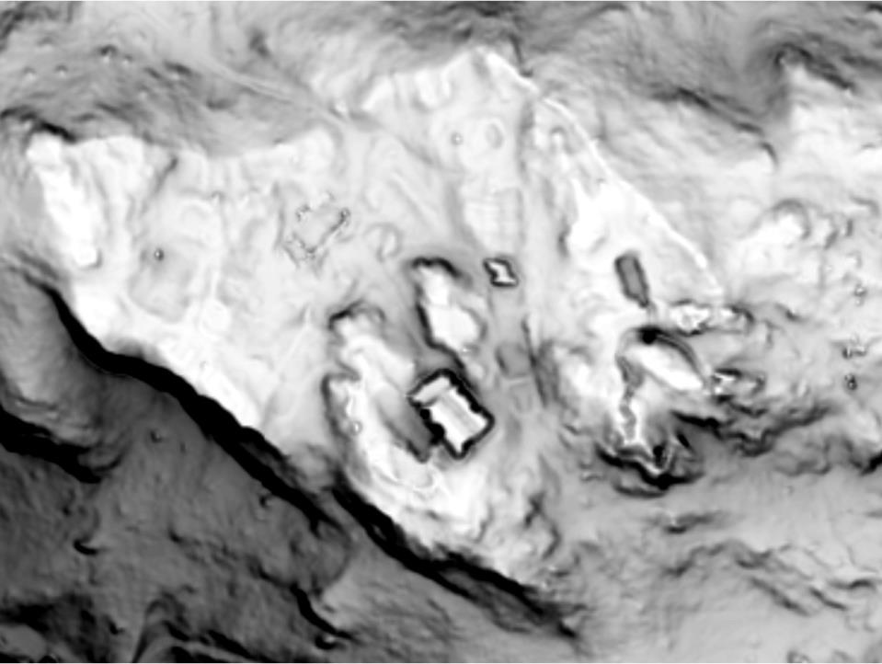
Diffuse solar insolation

Slide 46
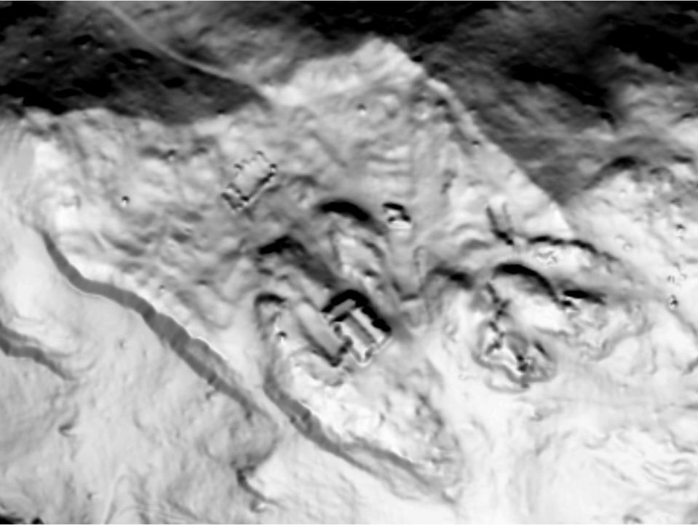
Global solar insolation

Slide 47
Solar insolation
preserves a sense of general topography
suitability of land for human activities
complex and time consuming calculations
numerous options can confuse the user
“washout effect” on very flat terrain

Slide 48
There‘s more?!!!
Planimetric and profile curvature
Contextual filtering
  edge detection (Laplacian, Sobel’s, Rober’s, Prewitt, Frei and Chen…)…
Lambertian relief shading
Multidirectional oblique-weighted (MDOW) shaded relief
Cumulative visibilty
Local dominance
Accessibility (Miller 1994)
Multi Scale Integral Invariant (Mara 2012)
…

Slide 49
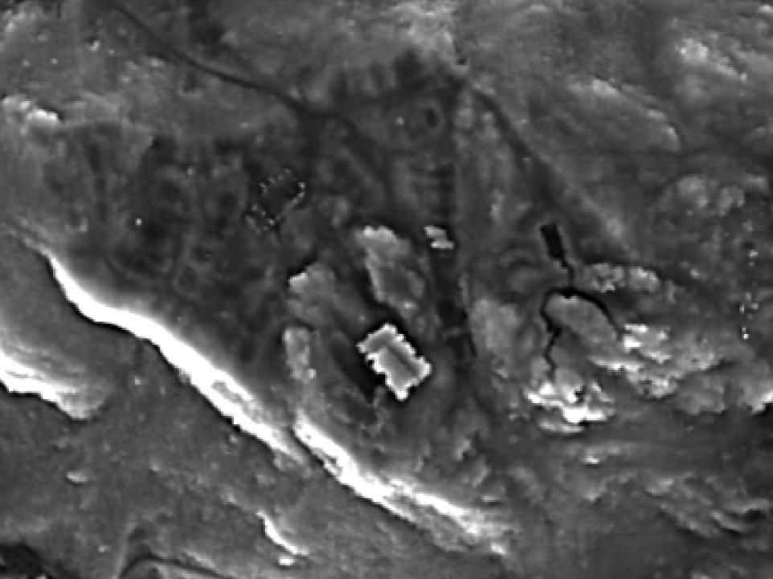
Multi Scale Integral Invariant
8
0
50 m

Slide 50
What to use?

Slide 51
What to use?
depends on:
  data collection and processing
  terrain
  features
  …

Slide 52
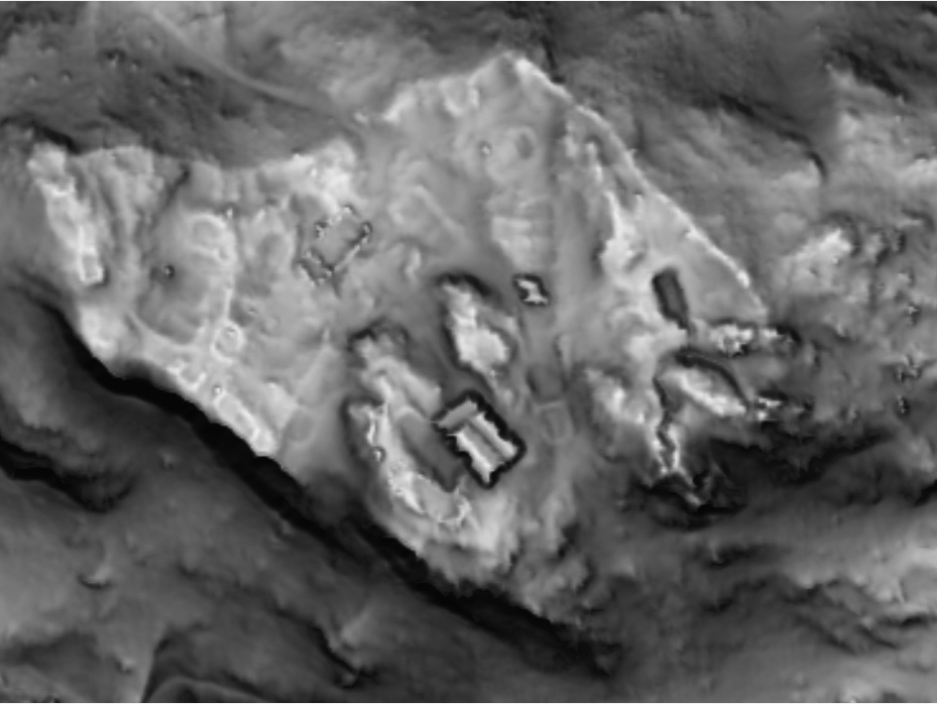
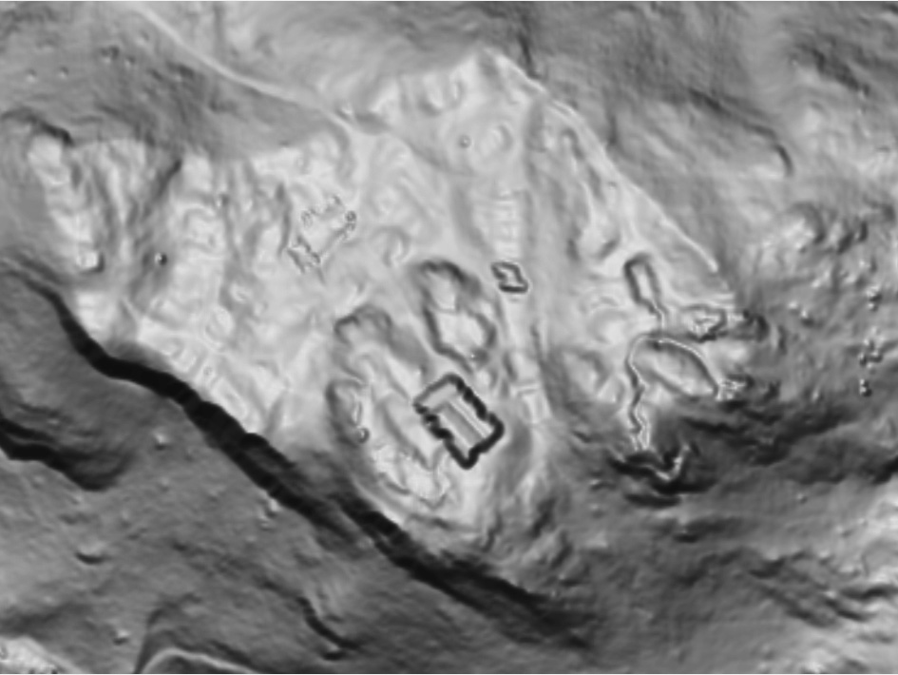

A solution?
9
a combinaton of hillshade, slope severity and SVF

Slide 53
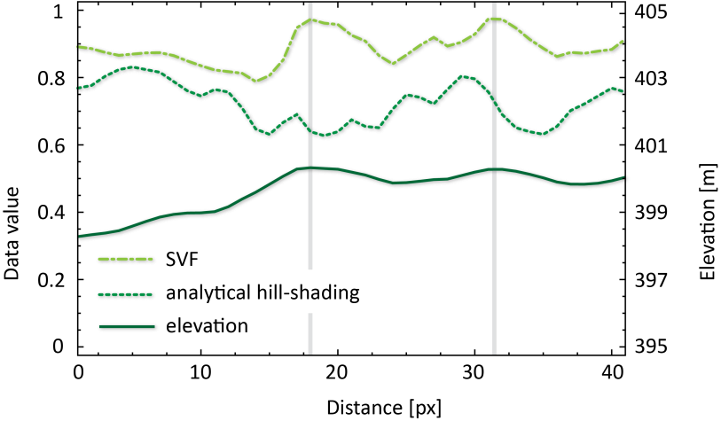
Recording… what?

Slide 54
Visualizations for scientific publications
because several factor have a big influence on how features are displayed it is imperative to include at least the following into the description of an image:
  visualization method
  colour legend
  data range
  data stretch type

Slide 55
Some help
  http:\\iaps.zrc-sazu.si/en/svf
  Relief Visualization Toolbox standalone and IDL code
  http://sourceforge.net/projects/livt/
  Lidar Visualisation Toolbox standalone

Slide 56
References
Kokalj, Ž., Oštir, K., Zakšek, K. 2011. Application of sky-view factor for the visualization of historic landscape features in lidar-derived relief models. Antiquity 85, 327: 263-273.
Kokalj, Ž., Zakšek, K., Oštir, K. 2013. Visualizations of lidar derived relief models. In: Opitz, R., Cowley., D. (eds) Interpreting archaeological topography – airborne laser scanning, aerial photographs and ground observation. Pp. 100-114.
Štular, B., Kokalj, Ž., Oštir, K., Nuniger, L. 2012. Visualization of lidar-derived relief models for detection of archaeological features. Journal of Archaeological Science 39: 3354-3360.
Yoëli, P. 1965. Analytische Schattierung. Ein kartographischer Entwurf. Kartographische Nachrichten 15: 141-148.
Devereux, B.J., Amable, G.S., Crow, P. 2008. Visualisation of LiDAR terrain models for archaeological feature detection. Antiquity 82, 316: 470-479.
Challis, K. 2006. Airborne laser altimetry in alluviated landscapes. Archaeological Prospection 13, 2: 103-127.
Challis, K., Kokalj, Ž., Kincey, M., Moscrop, D., Howard, A.J. 2008. Airborne lidar and historic environment records. Antiquity 82, 318: 1055-1064.
Hesse R. 2010. LiDAR-derived Local Relief Models - a new tool for archaeological prospection. Archaeological Prospection 17, 2: 67-72.
Doneus, M., Briese, Ch. 2006. Full-waveform airborne laser scanning as a tool for archaeological reconnaissance. In: "From Space To Place. Proceedings of The 2nd International Conference On Remote Sensing In Archaeology", Bar International Series, 1568 (2006), 99 - 105, December 2006.
Doneus, M. 2013. Openness as visualization technique for interpretative mapping of airborne LiDAR derived digital terrain models. Remote Sensing 5: 6427-6442.

Slide 57
Thank you for your attention!
ziga.kokalj@zrc-sazu.si
  http:\\iaps.zrc-sazu.si/en/rvt

